Slide 1
ATE 252 Introduction to Electricity
Instructor:
Patricia Thompson

Slide 2
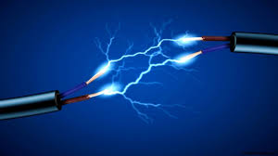
Electricity
What is it?
Movement of electrons
Brief history
2750 bc – Greeks
1600 ad – Gilbert defined static electricity
elektron, the Greek word for "amber”

Slide 3
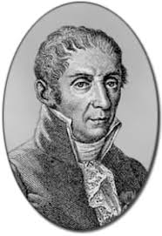
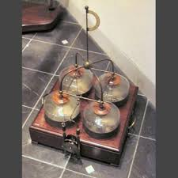
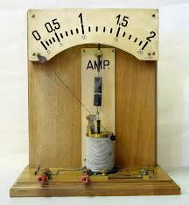
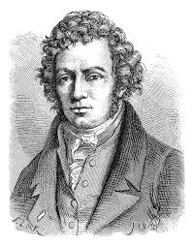
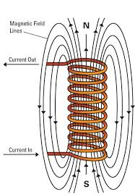
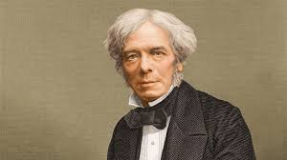
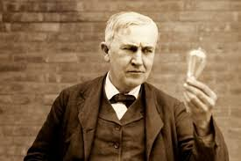
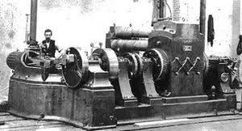
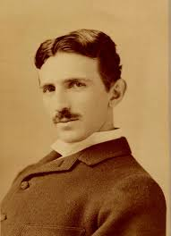
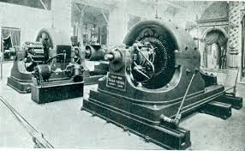
Electricity
History
1800’s
Alessandro Volta
André-Marie Ampère
Michael Faraday
Thomas Edison
Nikola Tesla
Many other inventors

Slide 4
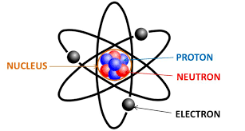
Electricity
Atom
Proton
Positive charge
Small and dense
Neutron
No charge
Along with protons, make up the nucleus
Electron

Slide 5
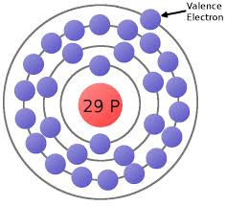
Electricity
Electron
Negative charge
Large and light
Float around the nucleus
Valence electrons
Electrons furthest away from nucleus
Maximum of eight valence electrons

Slide 6
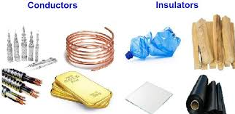
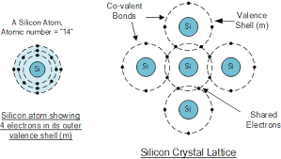
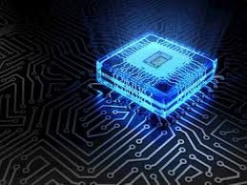
Electricity
Conductors
One or two valence electrons
Aluminum, gold, copper, silver
Insulators
Seven or eight valence electrons
Wood, glass, rubber, plastic
Semiconductors
Four valence electrons
Silicon

Slide 7
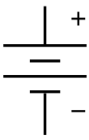
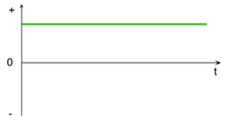
Electricity
Two types of current
Direct current (DC)
Electrons continuously move in one direction
Batteries, DC power supplies
Have a positive and a negative

Slide 8
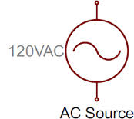
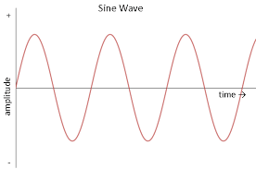
Electricity
Two types of current
Alternating current (AC)
Electrons move together but change directions

Slide 9
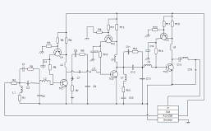
Schematic
Standard method of drawing electrical circuits
Shows what components are in the circuit
How the components are connected to each other
Helps to organize for installation and troubleshooting

Slide 10
Schematics
Actual
Schematic

Slide 11
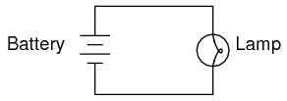
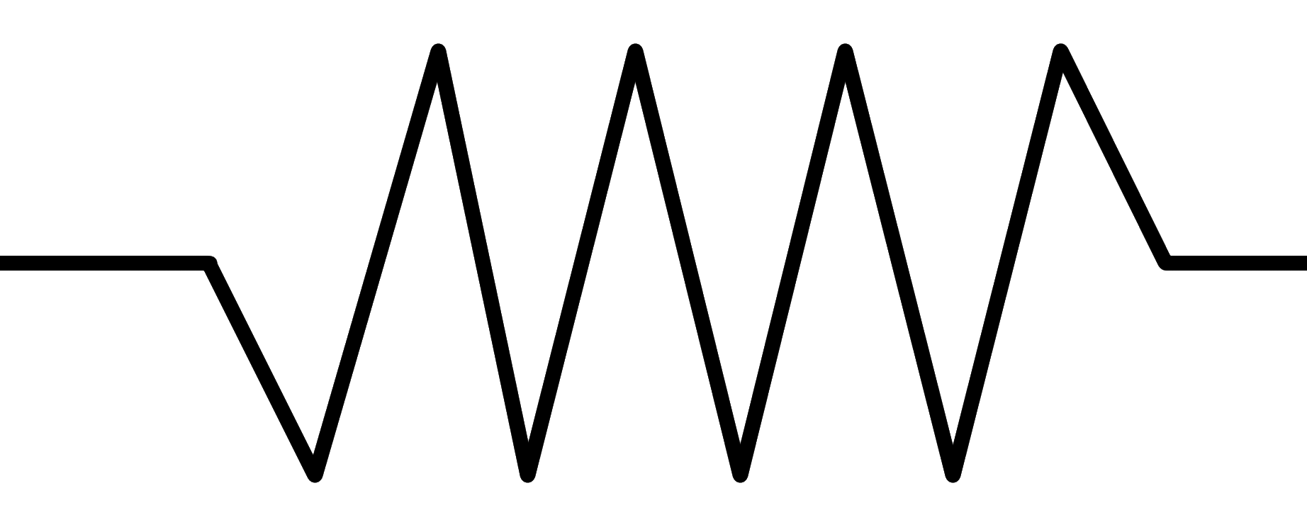
Circuit
Complete circuit
Must have
At least one continuous path
Power source
Load
Conductor
Insulator

Slide 12
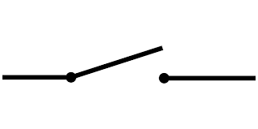
Circuit
Usually will also have
Control device
Switch
Protective device
Fuse

Slide 13
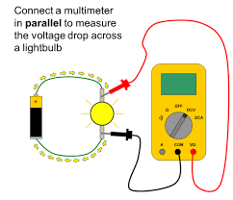
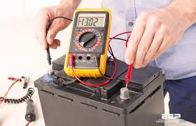
Four Quantities
Voltage
Force that starts electrons moving
Also known as Electromotive Force (EMF)
Abbreviation: V (or E)
Unit: Volt (V), named for Alessandra Volta
Measured in parallel
Schematic symbol:
DC AC

Slide 14
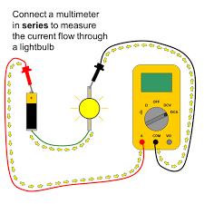
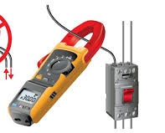
Four Quantities
Current
Rate the electrons flow
Abbreviation: I
Unit: Ampere (Amp or A)
Usually in mA, 1 mA=0.001A
Measured:
DMM: in series
Clampmeter: clamp wire
Schematic Symbol:

Slide 15
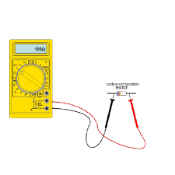
Four Quantities
Resistance
Opposed the flow of electrons
Abbreviation: R
Unit: Ohm (Ω)
Could be kΩ, 1 kΩ = 1000 Ω
Measured in parallel with at least one end disconnected from circuit
Schematic symbol:

Slide 16
Four Quantities
Power
Rate energy is converted
Abbreviation: P
Unit: Watt (W) after James Watt
Charged by kWhr, 1kW = 1000W
Measured with a wattmeter or calculated value
Schematic symbol: Not shown

Slide 17
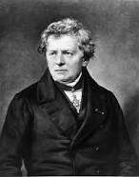
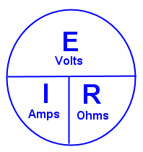
Four Quantities
Related to each other by
Ohm’s Law
Relationship between voltage, current, and resistance (V, I, and R).
V = IR

Slide 18
Circuits
Series
Parallel
Combination (Series and parallel)

Slide 19
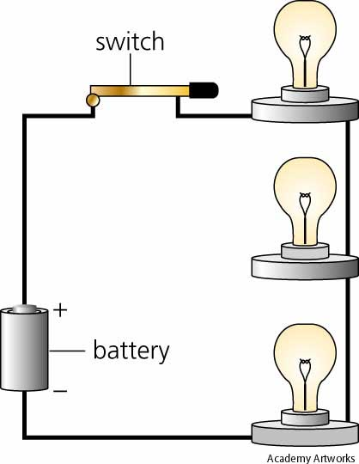
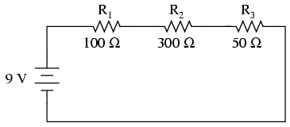
Series Circuits
Components are connected end to end
Only one path for current flow

Slide 20
Series Circuits
Advantage
Distribute voltage across many devices
Lower power consumption so lower cost
Disadvantage
If one component goes bad, all components will turn off

Slide 21
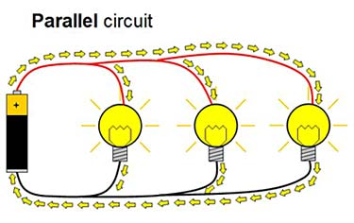
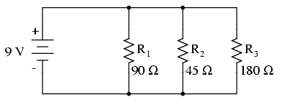
Parallel Circuits
Two or more paths for current to flow
Components positive and negative terminal s are connected to each other

Slide 22
Parallel Circuits
Advantage
If one component is off, others will remain on
Control of current flow
Disadvantage
Higher power consumption so higher cost

Slide 23
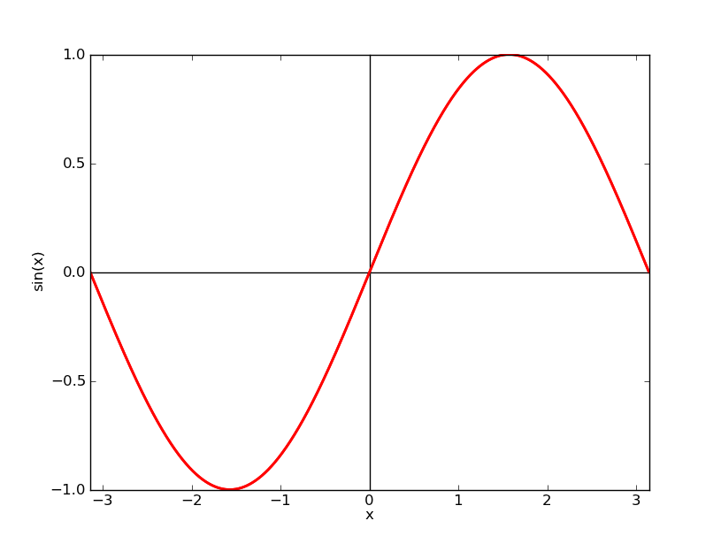
Analog vs digital
Analog signals have a range of values
1.0 V
0.75 V
0.5 V
0V

Slide 24
Analog vs digital
Digital signals have two discrete values
5 V
5 V
0 V
0 V

Slide 25
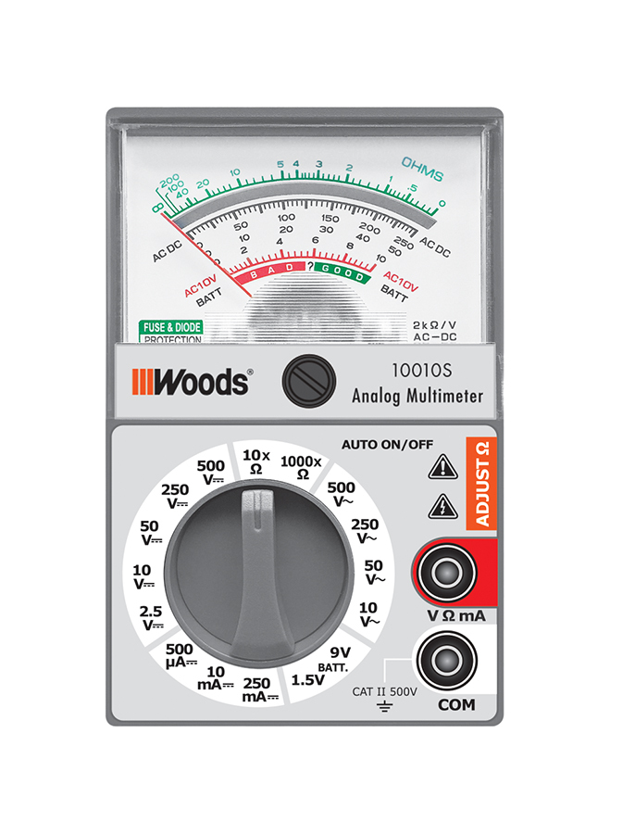
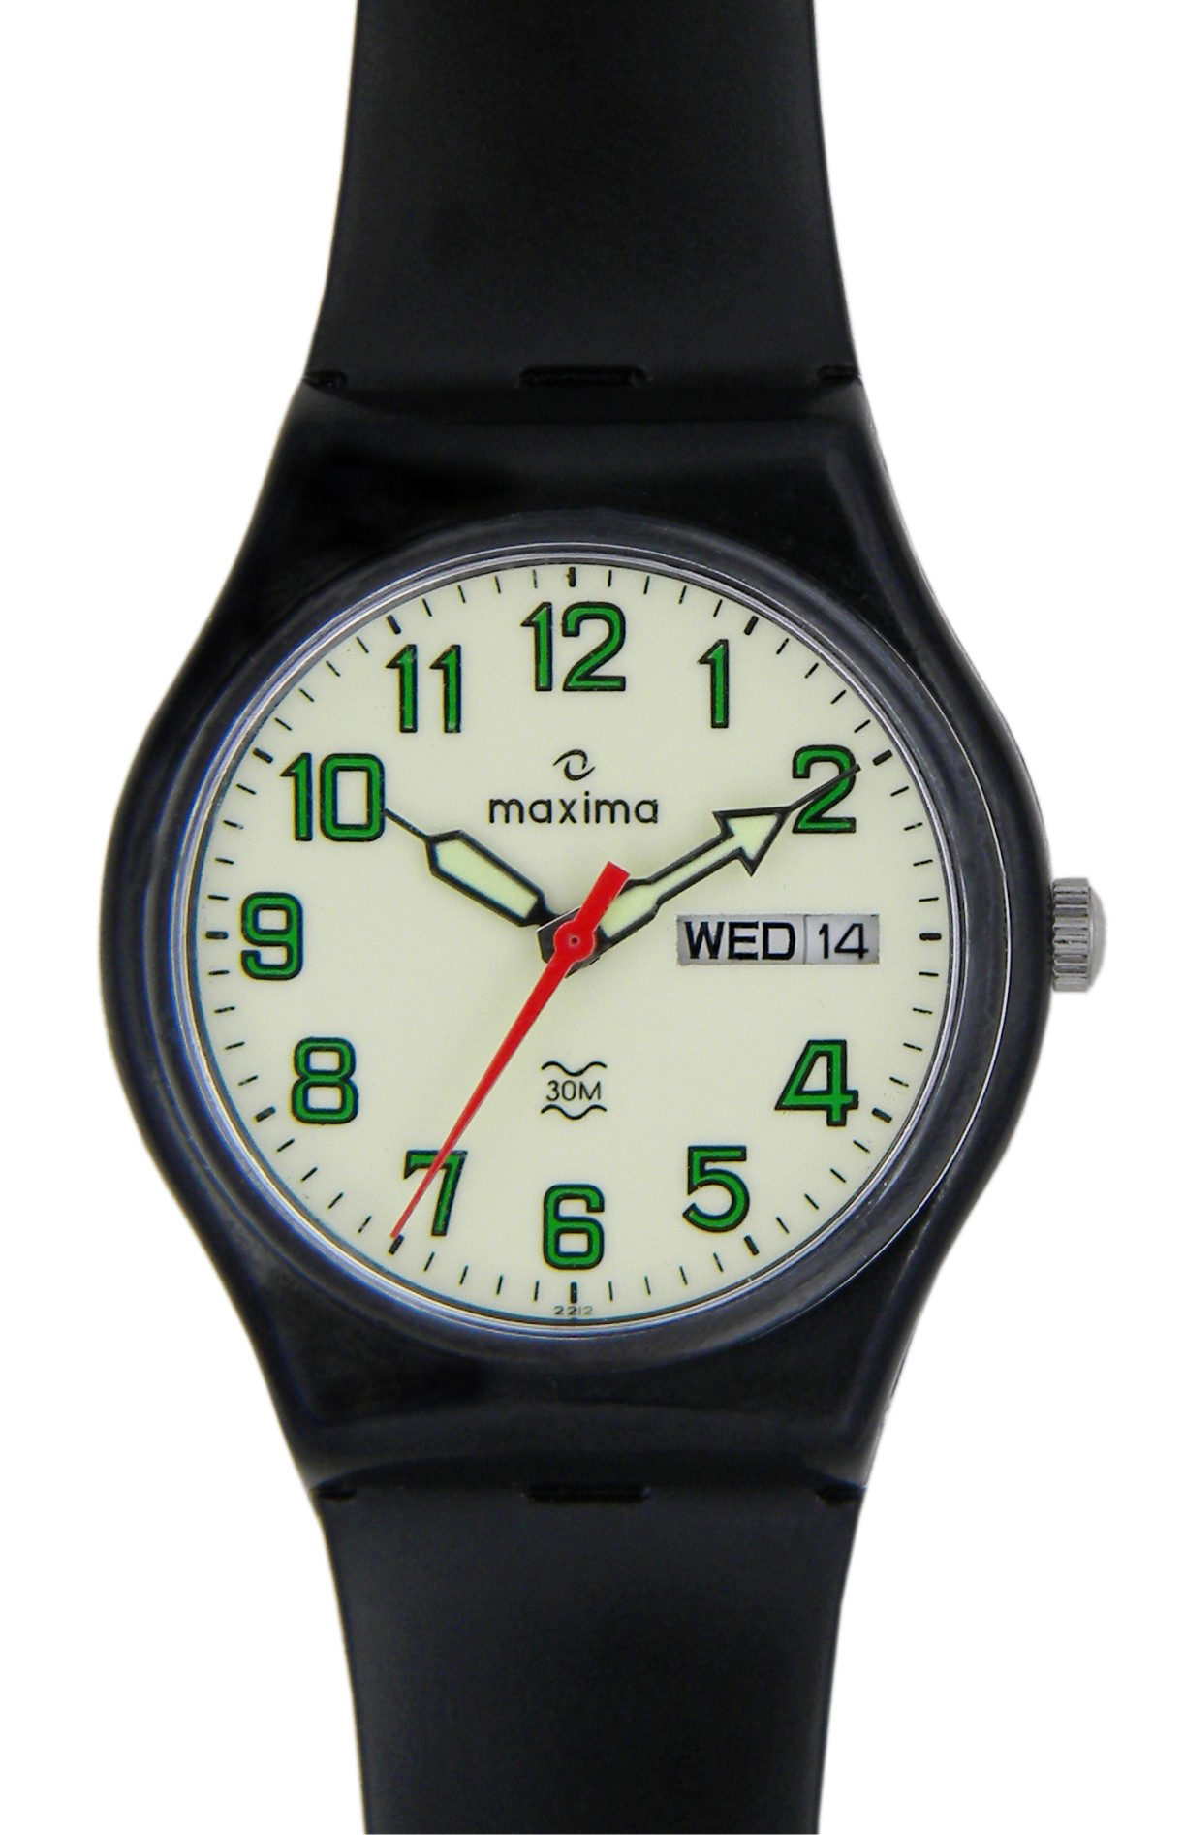
Analog vs digital
Analog devices

Slide 26
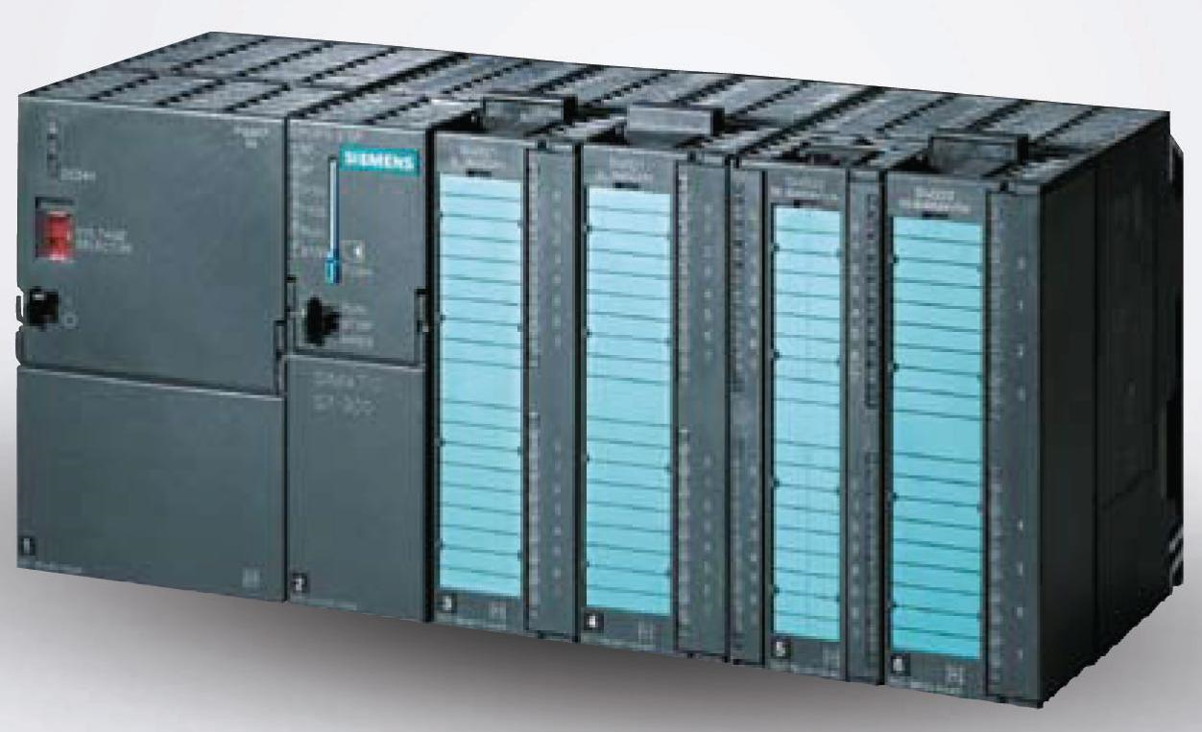
Analog vs digital
Digital devices

Slide 27
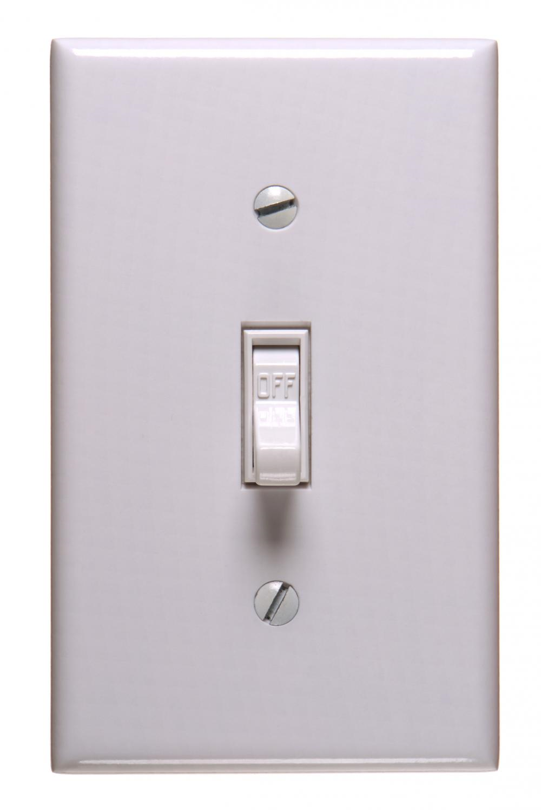
Digital signals
Digital signals can be compared to a light switch, it is either on or off
On may be referred to as Off may be referred to as
High • low
Logic 1 • Logic 0
On • off

Slide 28
Logic gates
Seven basic gates
AND
OR
NOT
NAND
NOR
Exclusive OR (XOR)
Exclusive NOR (XNOR)

Slide 29
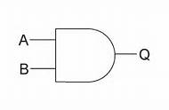
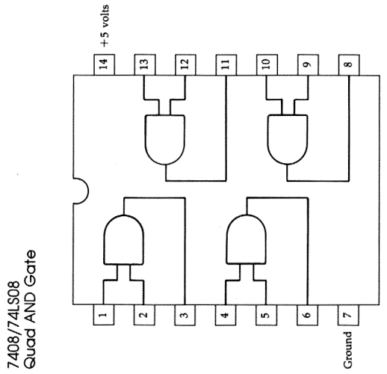
AND gate
Schematic
Truth table
Mathematical expression
A X B = A $∙B=AB=Q$
Common ic chip
7408 chip
Contains 4 gates
Pin 7: gnd
Pin 14: v_{cc} = +5 V
pins 1 & 2, 4 & 5, 9 & 10, and 12 & 13: inputs
Pins 3, 6, 8, and 11: outputs
A | B | Q
0 | 0 | 0
0 | 1 | 0
1 | 0 | 0
1 | 1 | 1

Slide 30
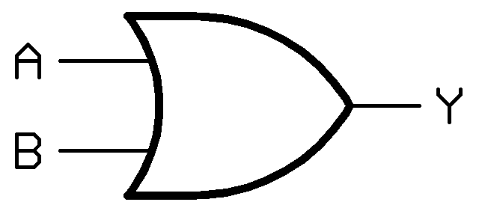
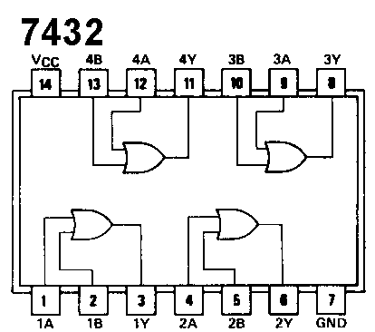
OR gate
Schematic
Truth table
Mathematical expression
A + B = Q
Common ic chip
7432 chip
Contains 4 gates
Pin 7: gnd
Pin 14: v_{cc} = +5 V
pins 1 & 2, 4 & 5, 9 & 10, and 12 & 13: inputs
Pins 3, 6, 8, and 11: outputs
A | B | Q
0 | 0 | 0
0 | 1 | 1
1 | 0 | 1
1 | 1 | 1

Slide 31
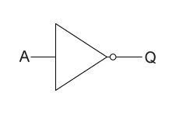
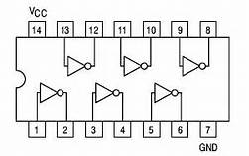
NOT gate
inverter
Schematic
Truth table
Mathematical expression
$\overline{A}=Q$
Common ic chip
7404 chip
Contains 6 gates
Pin 7: gnd
Pin 14: v_{cc} = +5 V
pins 1, 3, 5, 9, 11, and 13: inputs
Pins 2, 4, 6, 8, 10, and 12: outputs
A | Q
0 | 1
1 | 0

Slide 32
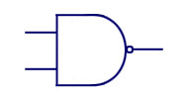
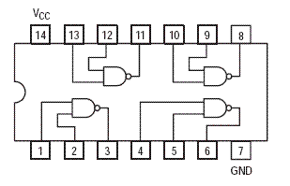
NAnd “not and” gate
Schematic
Truth table
Mathematical expression
$\overline{A X B}= \overline{A∗B}= \overline{AB}=Q$
Common ic chip
7400 chip
Contains 4 gates
Pin 7: gnd
Pin 14: v_{cc} = +5 V
pins 1 & 2, 4 & 5, 9 & 10, and 12 & 13: inputs
Pins 3, 6, 8, and 11: outputs
A
Q
B
A | B | Q
0 | 0 | 1
0 | 1 | 1
1 | 0 | 1
1 | 1 | 0

Slide 33
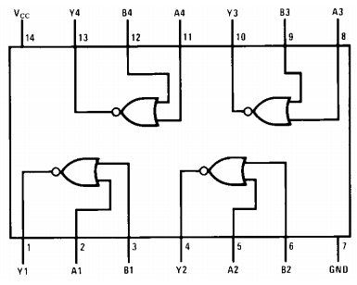
Nor “Not or” gate
Schematic
Truth table
Mathematical expression
$\overline{A+B }=Q$
Common ic chip
7402 chip
Contains 4 gates
Pin 7: gnd
Pin 14: v_{cc} = +5 V
pins 2 & 3, 5 & 6, 8 & 9, and 11&12: inputs
Pins 1, 4, 10, and 13: outputs
A | B | Q
0 | 0 | 1
0 | 1 | 0
1 | 0 | 0
1 | 1 | 0

Slide 34
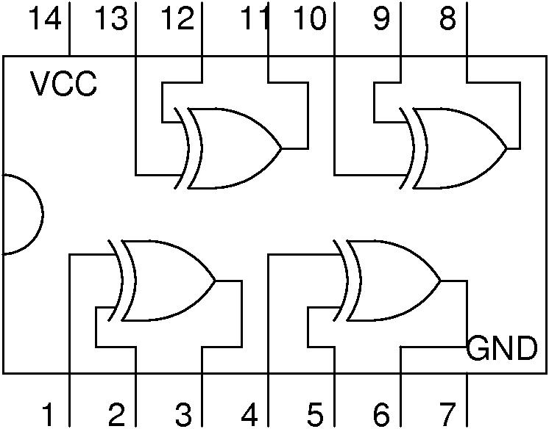
Xor “exclusive or” gate
Schematic
Truth table
Mathematical expression
$A ⊕B=Q$
Common ic chip
7486 chip
Contains 4 gates
Pin 7: gnd
Pin 14: v_{cc} = +5 V
pins 1 & 2, 4 & 5, 9 & 10, and 12 & 13: inputs
Pins 3, 7, 8, and 11: outputs
A | B | Q
0 | 0 | 0
0 | 1 | 1
1 | 0 | 1
1 | 1 | 0

Slide 35
xNor “exclusive nor” gate
Schematic
Truth table
Mathematical expression
$\overline{A⊕B }=Y$
Common ic chip
74266 chip
Contains 4 gates
Pin 7: gnd
Pin 14: v_{cc} = +5 V
pins 1 & 2, 5 & 6, 8 & 9, and 12 & 13: inputs
Pins 3, 4, 10, and 11: outputs
A | B | Y
0 | 0 | 1
0 | 1 | 0
1 | 0 | 0
1 | 1 | 1

